Slide 1
Electric vehicles and charging stations – most popular electric car in Washington State

Slide 2
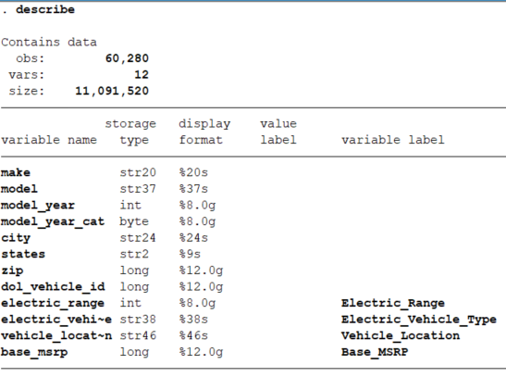

Slide 3
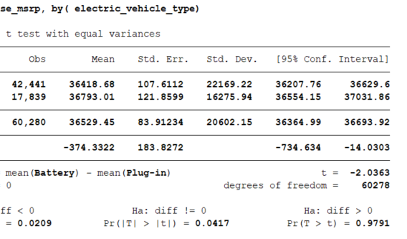
Plug-in vehicles are significantly more expensive than battery powered vehicles:
Average price:
$36793.01 ± $16275.94 vs. $36418.68 ± $22169.94, p=0.04
Notes:
One car was $845,000
Median price:
$35,000 (95% CI $29,010 - $37495) vs $34,095 (95% CI $31,770 - $39,145), p<0.01

Slide 4
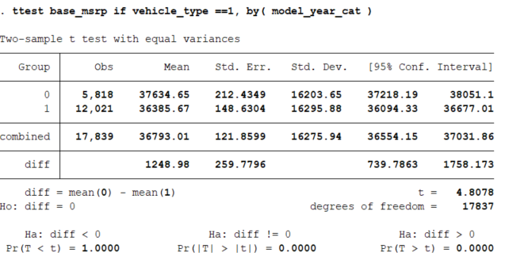
Plug-in vehicles made in 2016 and later were less expensive compared to plug-in vehicles made in 2015 or earlier:
Average price:
$36385.67 ± $16295.88 vs. $37634.65 ± $16203.65, p<0.01

Slide 5
No association between cars with longer ranges and prices

Slide 6
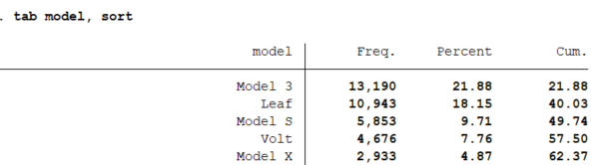
Top 5 electric cars driven in Washington State

Slide 7
Tesla vs Everyone Else

Slide 8
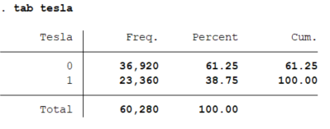
39% of people who drive electric vehicles own a Tesla

Slide 9
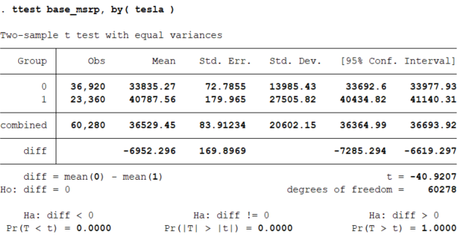
Tesla is significantly more expensive than other cars:
Average price:
$40787.56 ± $27505.8 vs. $33835.27 ± $13985.43, p<0.01

Slide 10
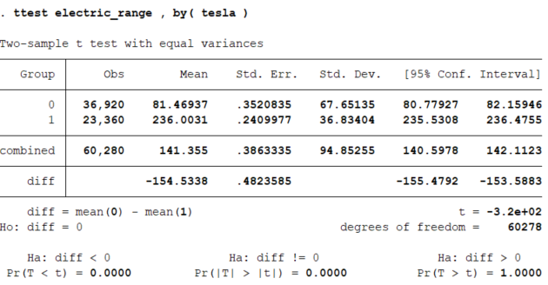
Tesla has significantly longer range compared to other cars:
Average mileage:
236.00 ± 36.8 vs. 81.5 ± 67.7, p<0.01

